Slide 1
ENGLISH CLASS
WEEK 15

Slide 2
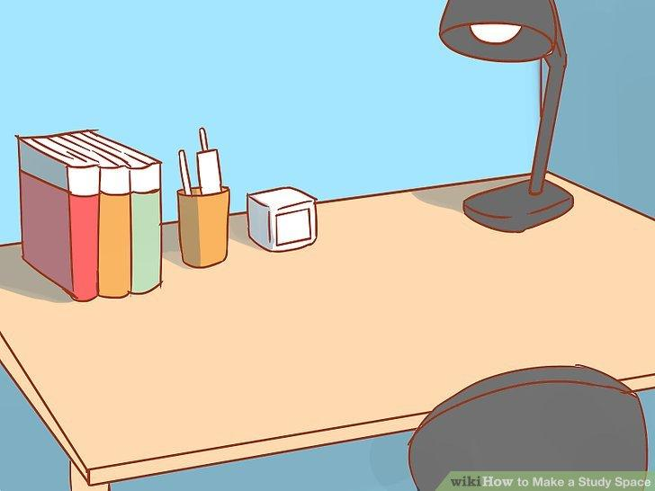
BEFORE WE START

Slide 3
OBJETIVO!
Identificar y nombrar colores en inglés para hacer agrupaciones usando objetos que se encuentran en casa.

Slide 4
TABLE OF CONTENTS
01
02
03
INICIO
DESARROLLO
CIERRE
Revisar el nombre de los colores
Ejercicios
Agrupar objetos

Slide 5
Inicio
01

Slide 6
Recuerdas estos 6 colores

Slide 7
WHAT COLOR IS IT?

Slide 8
WHAT COLOR IS IT?

Slide 9
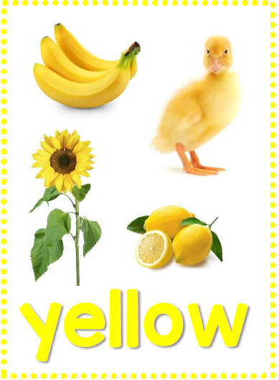
WHAT COLOR IS IT?

Slide 10
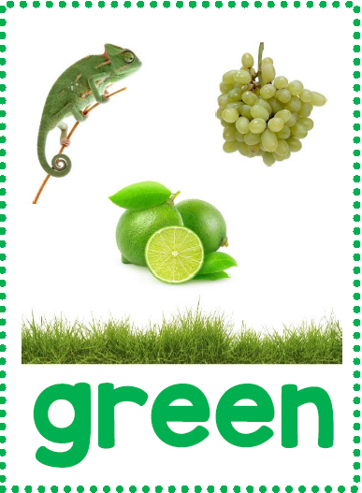
WHAT COLOR IS IT?

Slide 11
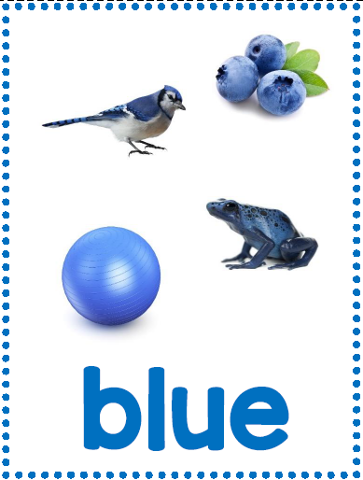
WHAT COLOR IS IT?

Slide 12
WHAT COLOR IS IT?

Slide 13
LET’S PRACTICE
02
DESARROLLO

Slide 14
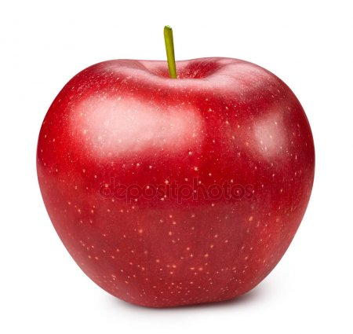
WHAT COLOR IS IT?
RED
BLUE

Slide 15
WHAT COLOR IS IT?
RED

Slide 16
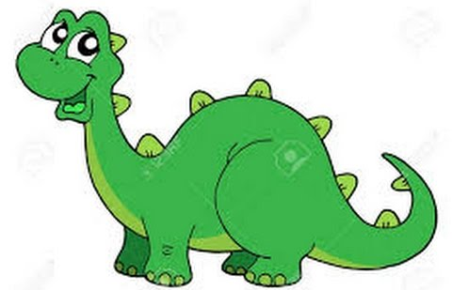
WHAT COLOR IS IT?
YELLOW
GREEN

Slide 17
WHAT COLOR IS IT?
GREEN

Slide 18
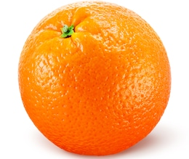
WHAT COLOR IS IT?
ORANGE
PURPLE

Slide 19
WHAT COLOR IS IT?
ORANGE

Slide 20
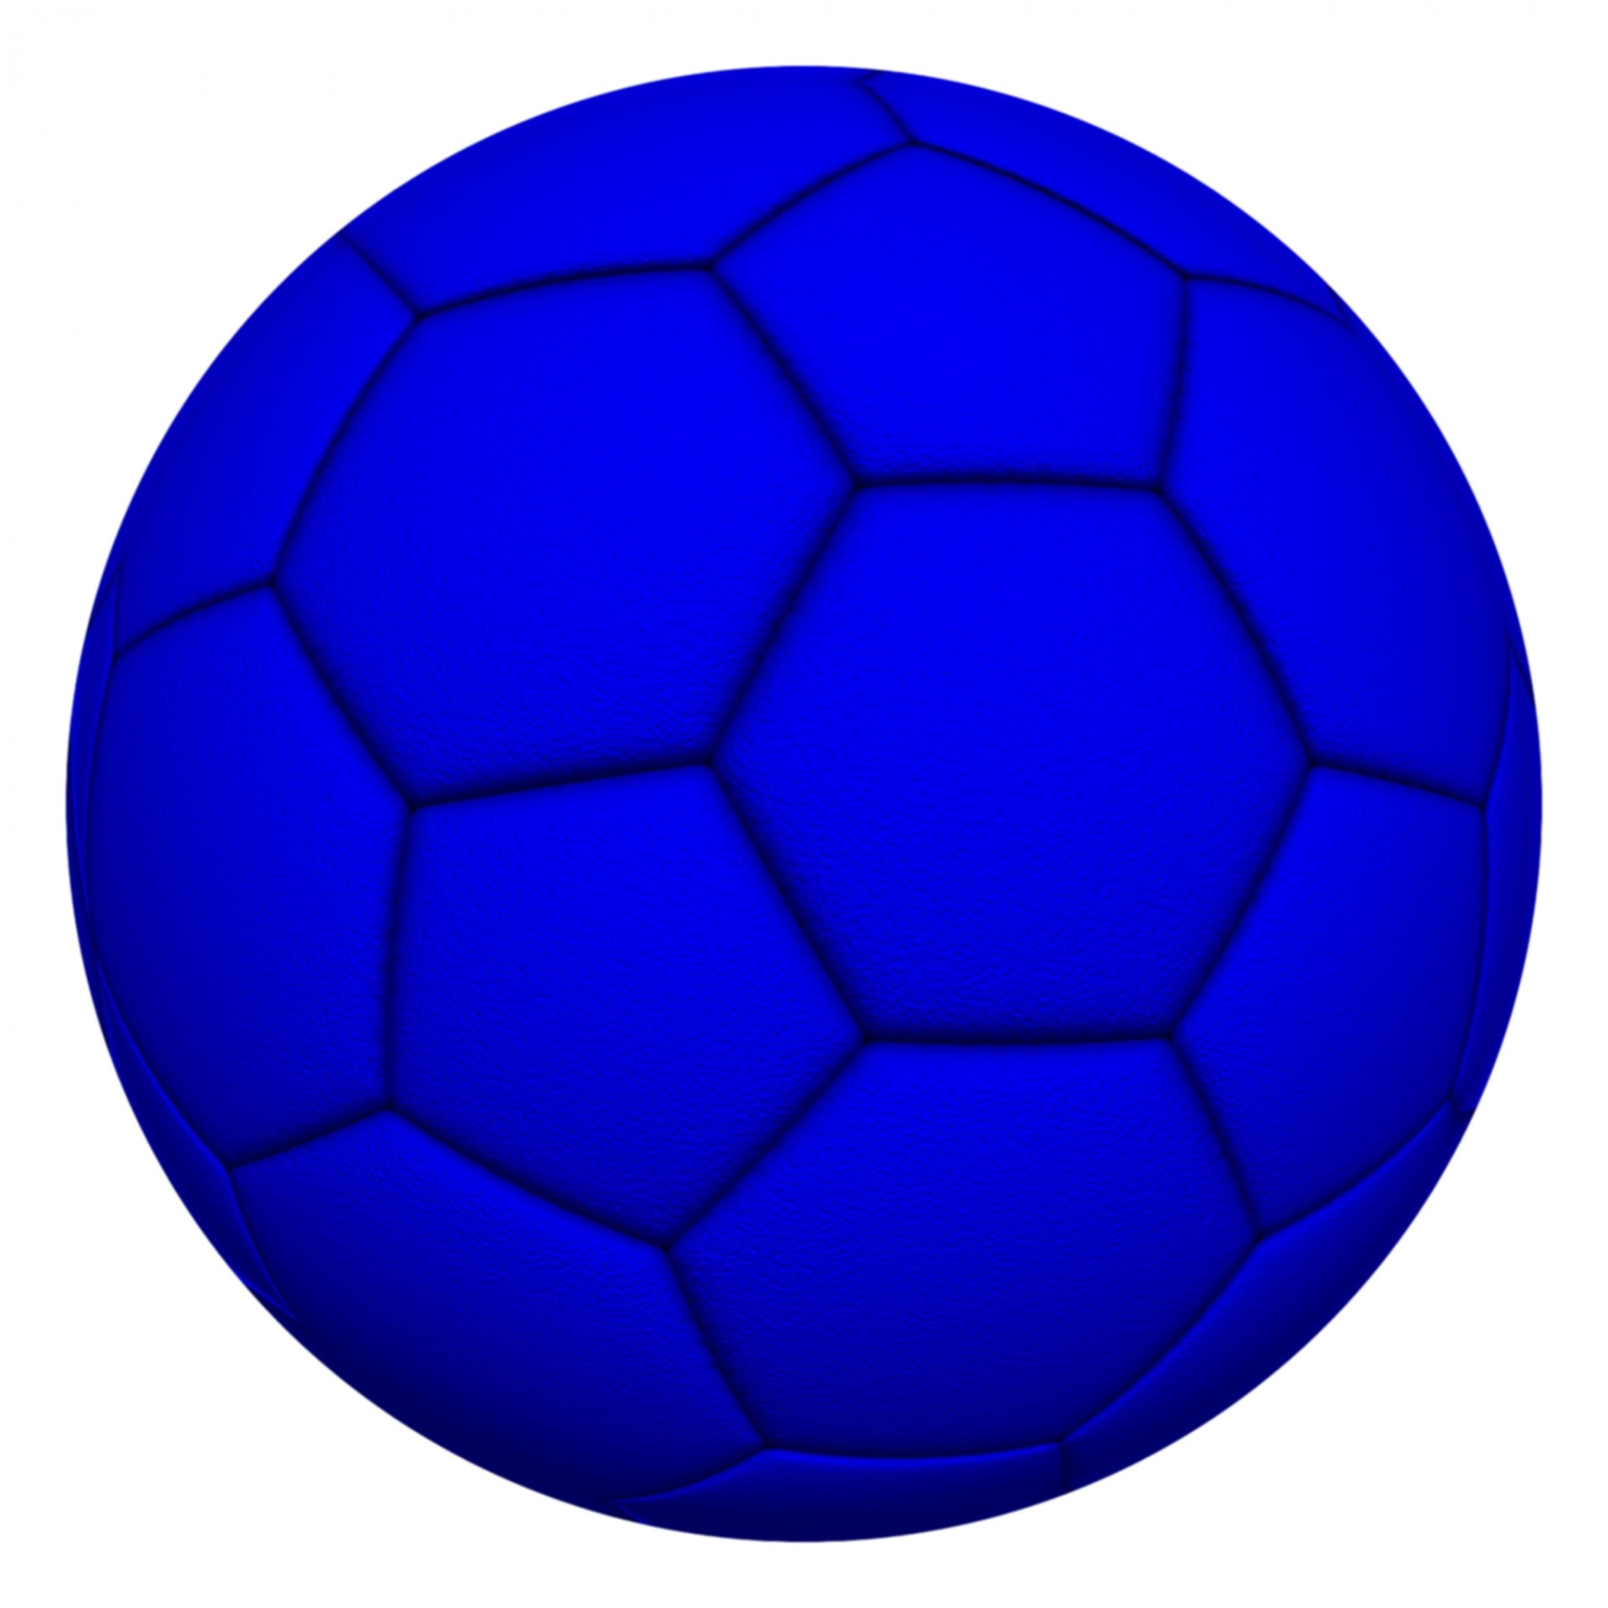
WHAT COLOR IS IT?
BLUE

Slide 21
WHAT COLOR IS IT?
GREEN
BLUE

Slide 22
AWESOME WORK

Slide 23
MATERIALS
Objetos de colores | Plumón o lápiz scripto | 6 hojas de papel

Slide 24
INSTRUCTIONS

Slide 25
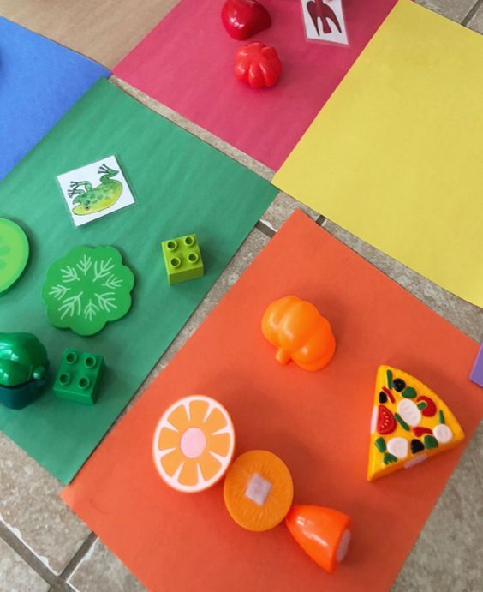

Slide 26
03
CIERRE

Slide 27
WHAT COLORS DID WE SEE TODAY?
RED
YELLOW
COLORS
BLUE
GREEN
ORANGE
PURPLE

Slide 28
Good job!
No olvides enviarme la foto o video del trabajo que realizaste hoy
+569 33009617

